Slide 1

Hackathon Repaying the Credit
Shanmugaiya Pandian. V

Slide 2
Agenda
Objective
Tools
File Details
Graphs
Recommendation
Presentation Title

Slide 3

Objective
Gold Atlantis, a credit-providing firm, observed a rise in the number of defaulters. Now, the firm is only interested in those consumers who have a lower probability of becoming a defaulter.
When Gold Atlantis receives a credit application, it approves or disapproves the application based on the applicant's profile. However, there are two types of risks that are associated with the firm's decisions:
If the applicant is likely to repay the loan, then disapproving the loan may result in a loss of business to the firm. If the applicant is not likely to repay the loan, that is if the applicant is a defaulter, then approving the loan may lead to a financial loss to the firm.
As an analyst, you need to analyze the credit data of Gold Atlantis, figure out various patterns in the data, and make interpretations. The aim of this analysis is to help the firm identify those customers who have a lower probability of becoming a defaulter.

Slide 4


* Python * Library. * Pre defined functions. * Loops (if, for) * Mapping
Tools

Slide 5
File Details
Import All Library
Read The File Using Pandas Library
Check The Rows and Columns -- 100000 rows and 24 columns
Check The Null Values – No Null Values Present In The file.
Missing Value Treatment
Separate the columns Categorical and Numerical

Slide 6

Missing Values Treatment
We Find the Missing values using isnull function Those Columns
Amount Good Price
Name Suite Type
Occupation Type
Count Family Members
Fix The Those Columns using fillna Function
With Mean and Mode.

Slide 7
Data Cleaning
Fix the Gender Columns With the Mode Value. (XNA to Female)
Fix the Family Status Columns With the Mode Value.
Income Type, Name Suite Type, Children Count, Total Documents , Family Members Count Mapping with Related Data for Some Accurate Values.

Slide 8
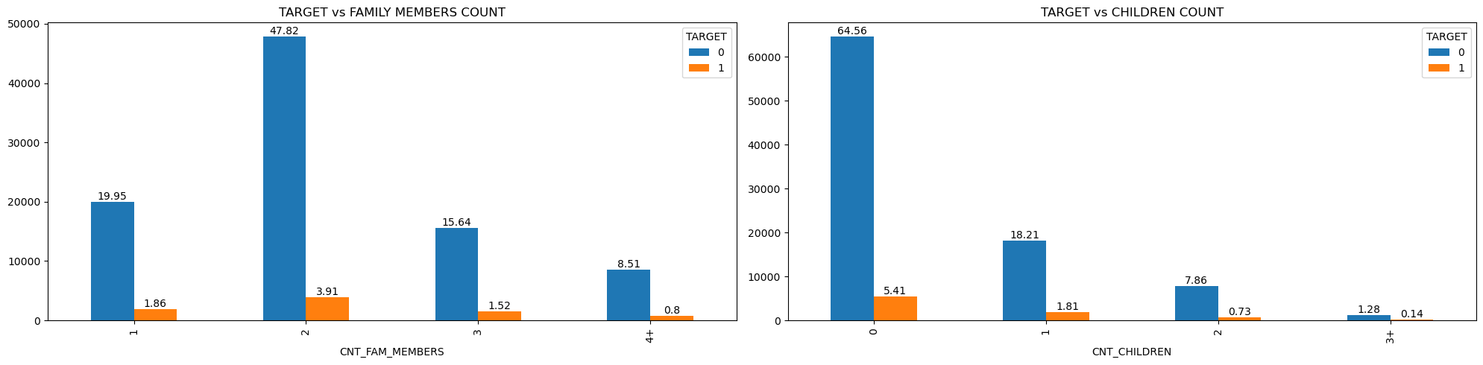
Analysis Defaulters using Family and children
In 2 members family 48% pay properly.
65% paying on time who dont have child.

Slide 9
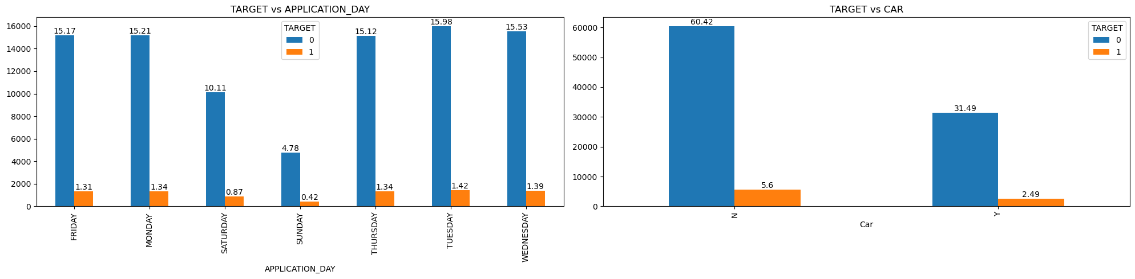
Analysis Defaulters using Application day & Car
Day Doesnt affect the repayment. Even through Tuesday and Wednesday who get loan they are paying properly.
60 % peoples dont have car but they pay on time.

Slide 10
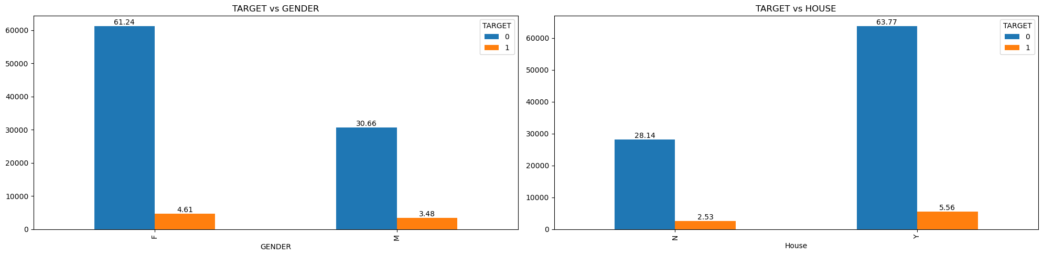
Analysis Defaulters using Gender & House
Alomost 61% female pay on time.
64% who have house they pay on time.

Slide 11
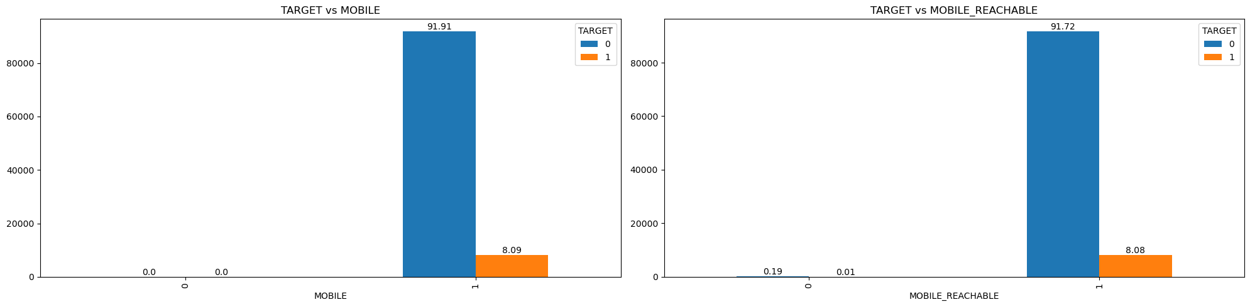
Analysis Defaulters using Mobile & Mobile Reachable
92% people paying on time they have mobile.
92% peoples phone reachable they pay on time.

Slide 12
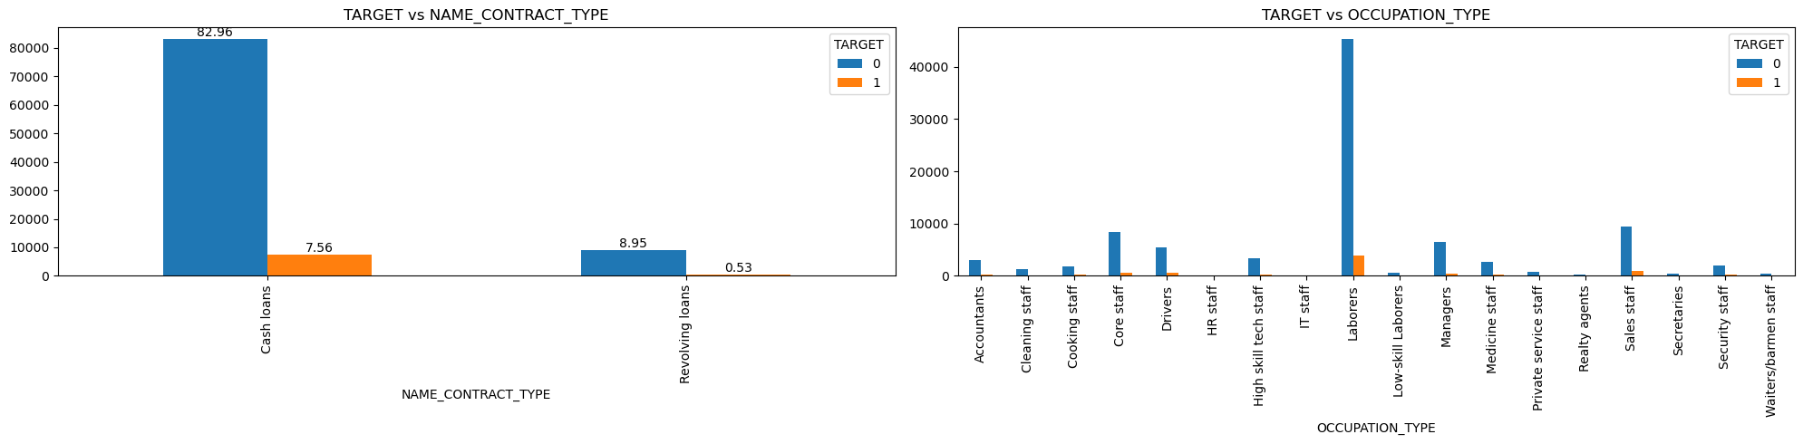
Analysis Defaulters using Contract Type & Occupation
83% cash loan repay on time
45 % labours are pay loan on time.

Slide 13
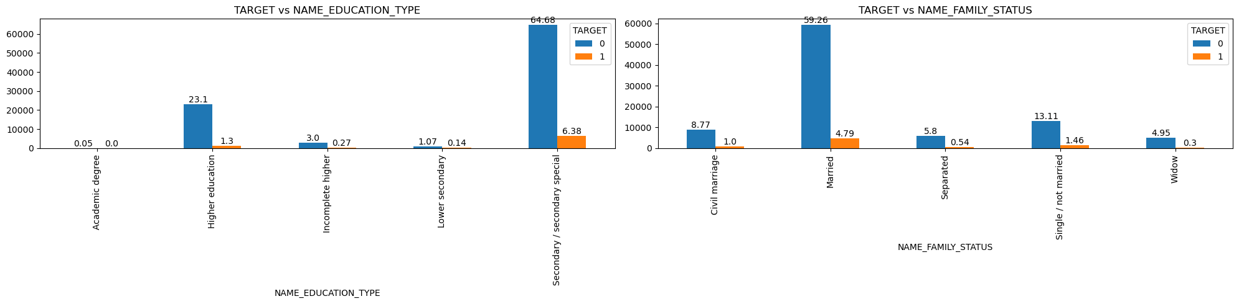
Analysis Defaulters using Education & Family Status
65 % secondary special study peoples pay on time.
59 % married peoples pay on time.

Slide 14
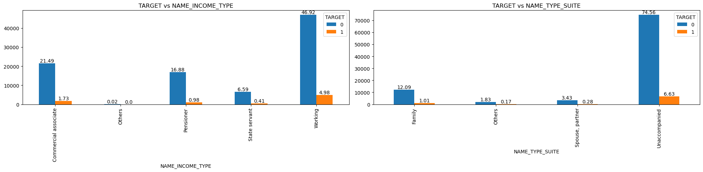
Analysis Defaulters using Income Type & Name Suite
47% working peoples are pay on time.
75 % unaccompanied peoples are repay on time.

Slide 15
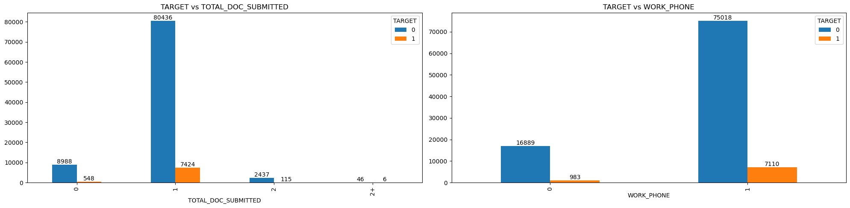
Analysis Defaulters using Total Document submitted & Work Phone
80% of peoples only 1 document submited. but they pay on time.
75 % people have work phone and pay also on time.

Slide 16
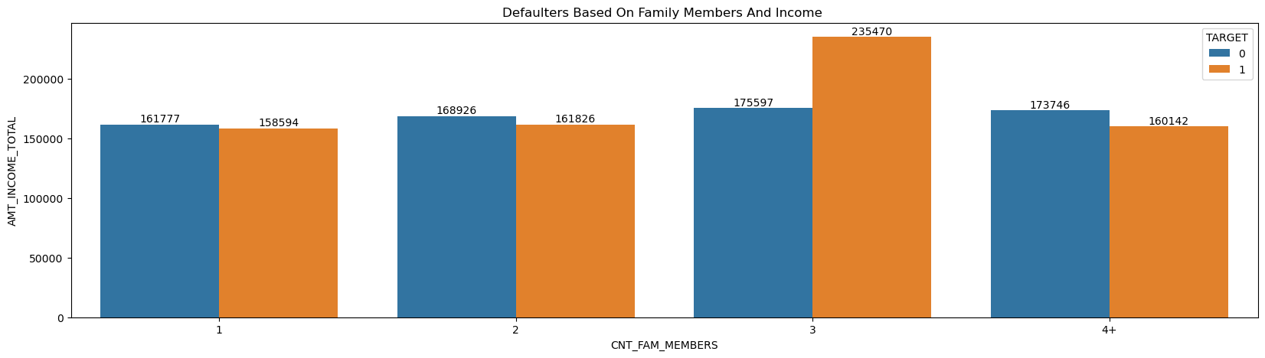
Who are become a low defaulter using their family members count with their income
Family members count which family have 2 members. They are low probabelity to become a defaulter.
Family members count which family have 3 members. They are high probabelity to become a defaulter.

Slide 17
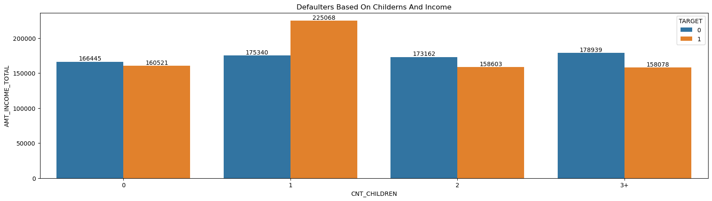
Who are become a low defaulter using their children count with their income
Who have 2 children they are probabelity to be a low defaulter.
Who have a one child high probabelity to be defaulter.

Slide 18
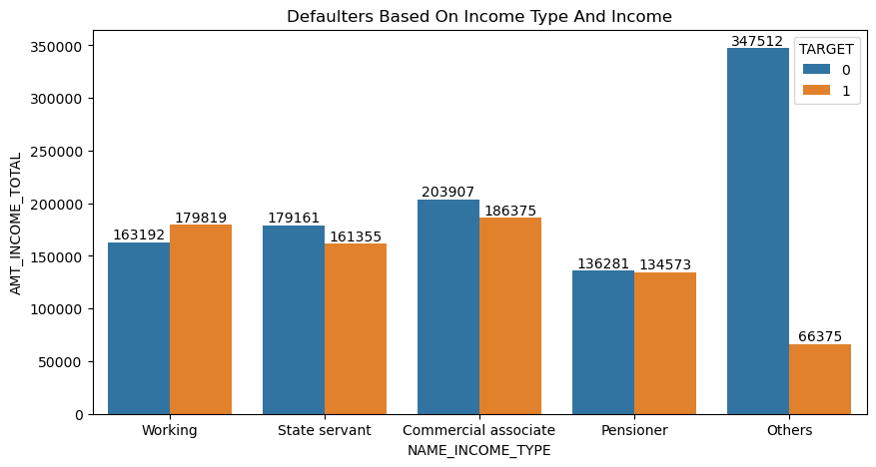
How we find low defaulter using their income type and income.
Who are under the others and State servant are be a low defaulter.
Working persons high possibality to be a defaulter.

Slide 19
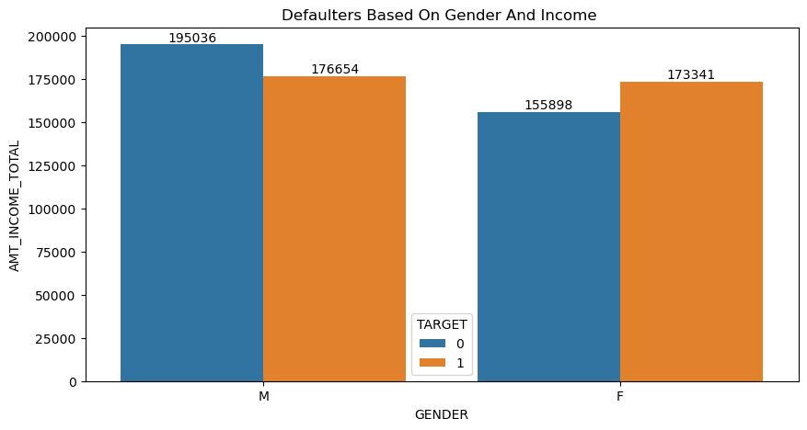
Which gender be a defaulter using their income
Males are low probabelity to become a defaulter.
Females are high probabelity to become a defaulter.

Slide 20
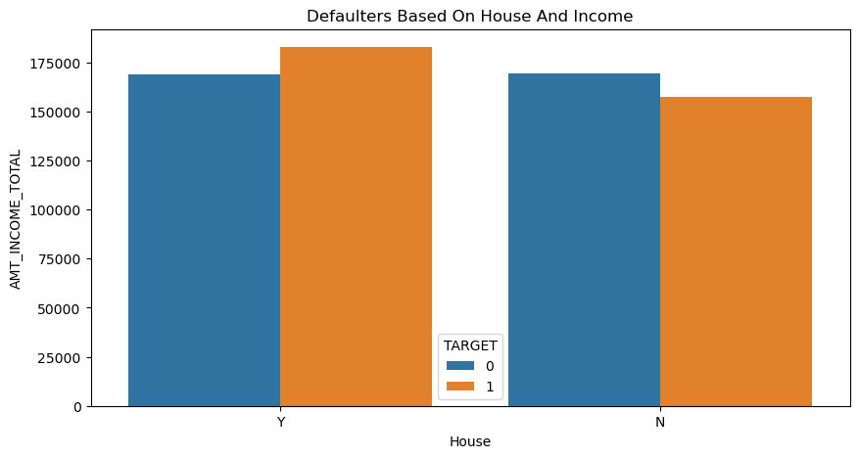
Find the defaulter using their house
Who have not a house they are low probabelity to become a defaulter.
Who have a house they are high probabelity to become a defaulter.

Slide 21
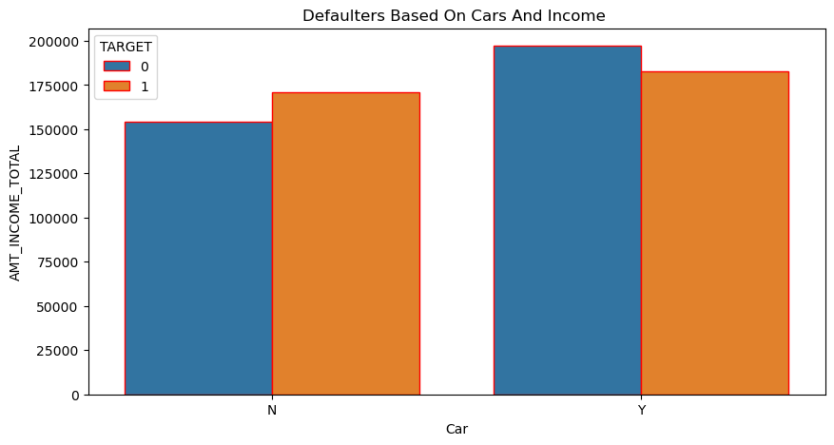
Find the defaulter using their car¶
Who have cars they are low probabelity to become a defaulters.
Who doesn't have cars they are high probabelity to become a defaulters.

Slide 22
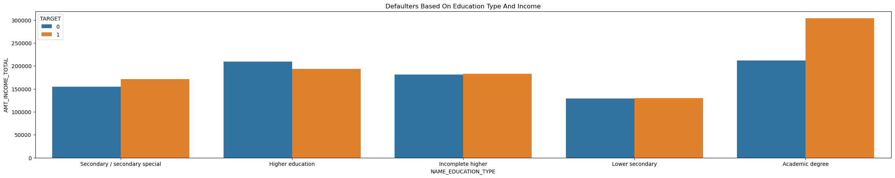
Finding defaulters their education type and income
Higher education studied applicant low possibility become a defaulter.
Acadamic degree and secondary are high possibility to become a defaulter.

Slide 23
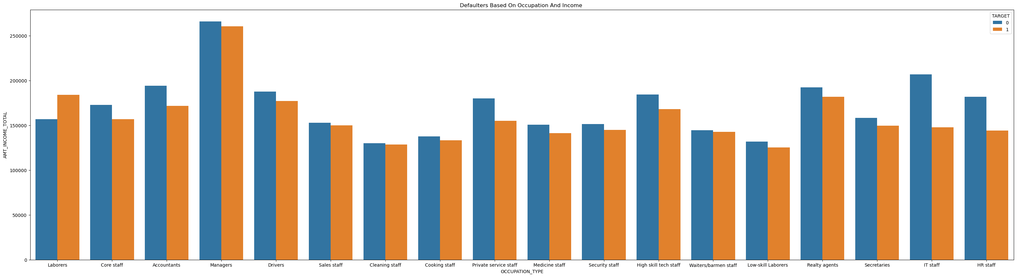
Who are become a defaulter using their occupation and income
Manager, core staff, accountant,drivers,private service staff, Hr and It staff are low probability to become a defaulter.
Laborers high possibility become a defaulter.

Slide 24
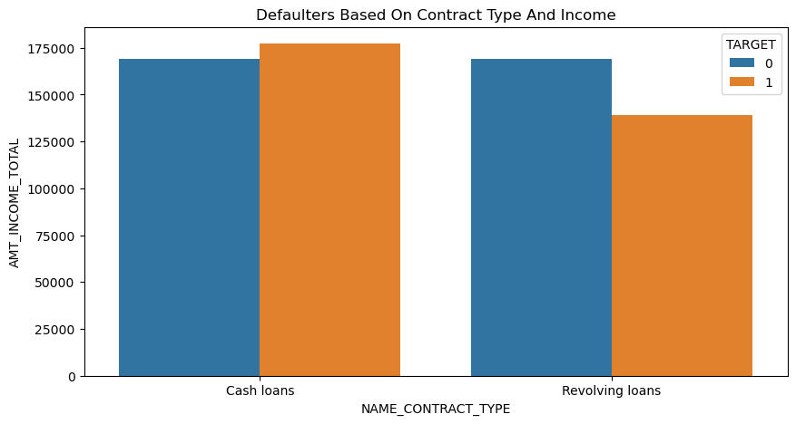
Finding defaulters using loan type
Rovolving loans are low probability to become a defaulter.
Cash loans are high probability to become a defaulter.

Slide 25


Recommendation -- Low Probability to Become a Defaulter
Family members count which family have 2 members. They are low probability to become a defaulter.
Who have 2 children they are probability to be a low defaulter.
Who are under the others and State servant are be a low defaulter.
Males are low probability to become a defaulter.
Who have not a house they are low probability to become a defaulter.
Who have cars they are low probability to become a defaulters.
Higher education studied applicant low possibility become a defaulter.
Manager, core staff, accountant ,drivers ,private service staff, Hr and It staff are low probability
to become a defaulter.
Revolving loans are low probability to become a defaulter.
Lot of male become a low defaulter using amount credit.
Who have the car they are low possible to become a defaulter using amount credit.
Amount credit and family members doesn't affect the become a defaulter. But one family member
little bit possible to become a defaulter.
Higher education high possible to become a low defaulter.
Who are married they are probability to become a low defaulter.
Who Are submitted More than 2 and 2+ document They are low possibility to become a defaulter.

Slide 26
Recommendation -- High Probability to Become a Defaulter
Family members count which family have 3 members. They are high probability to become a defaulter.
Who have a one child high probability to be defaulter.
Working persons high possibility to be a defaulter.
Females are high probability to become a defaulter.
Who have a house they are high probability to become a defaulter.
Who doesn't have cars they are high probability to become a defaulters.
Academic degree and secondary are high possibility to become a defaulter.
Laborers high possibility become a defaulter.
Cash loans are high probability to become a defaulter.
Academic degree who have high possible to become a high defaulter using amount credit.
Who are Widow they are become a high defaulter.

Slide 27




Thank you
Name : Shanmugaiya Pandian
Mail Id : pandi200ns@gmail.com

